Slide 1
User Research Summary
Prepared by the Digital Service at Veterans Affairs (DSVA)
Prepared for and presented to the VA Web Brand Consolidation Working Group
September 6, 2018

Slide 2
Outline
We gathered feedback from hundreds of Veterans about our plans for a new va.gov experience.
Study 1 – “Others” Resources Card Sort
Study 2 – Benefit Lifecycle Card Sort
Study 3 – Homepage Wireframes
Study 4 – Navigation Tree Test
Study 5 – Preview.va.gov Usability Test

Slide 3
Study 5 – Preview.va.gov Usability Test

Slide 4
Our goal was to assess the usability of the preview.va.gov on desktop and mobile
Study 5 – Preview.va.gov Usability Test
Visited Minneapolis, MN VAMC
Spoke with 14 Veterans of varying ages and races
8 Desktop, 6 Mobile
Used the live preview.va.gov website
Asked structured interview questions to gather feedback about the homepage, navigation, hub pages, and tool landing pages

Slide 5
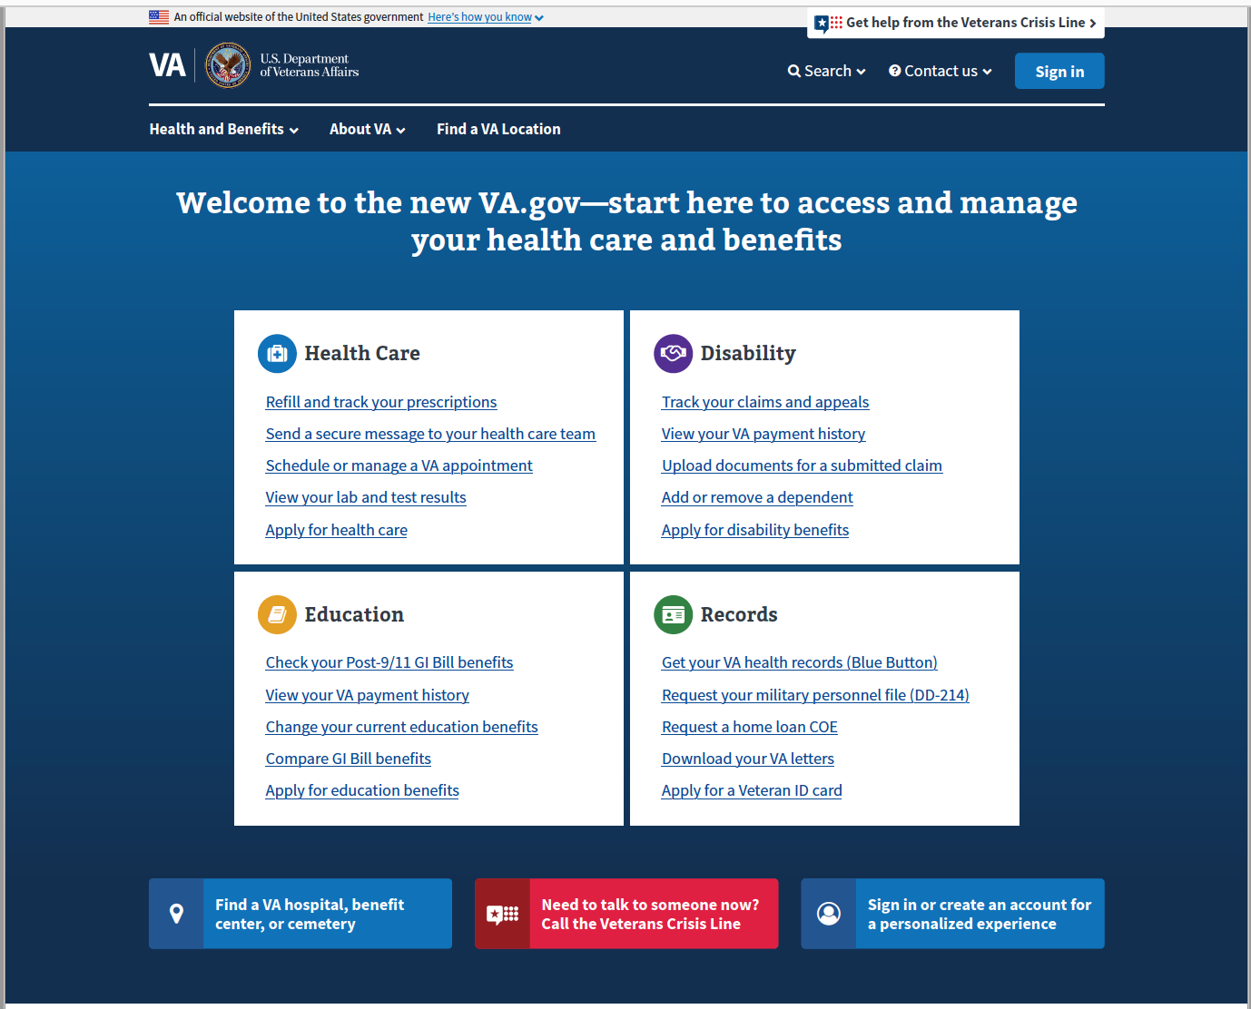
Preview.va.gov Homepage
Study 5 – Preview.va.gov Usability Test
Focused on first impressions and first clicks from the homepage
Directed users to the mega menu for feedback on options and usefulness

Slide 6
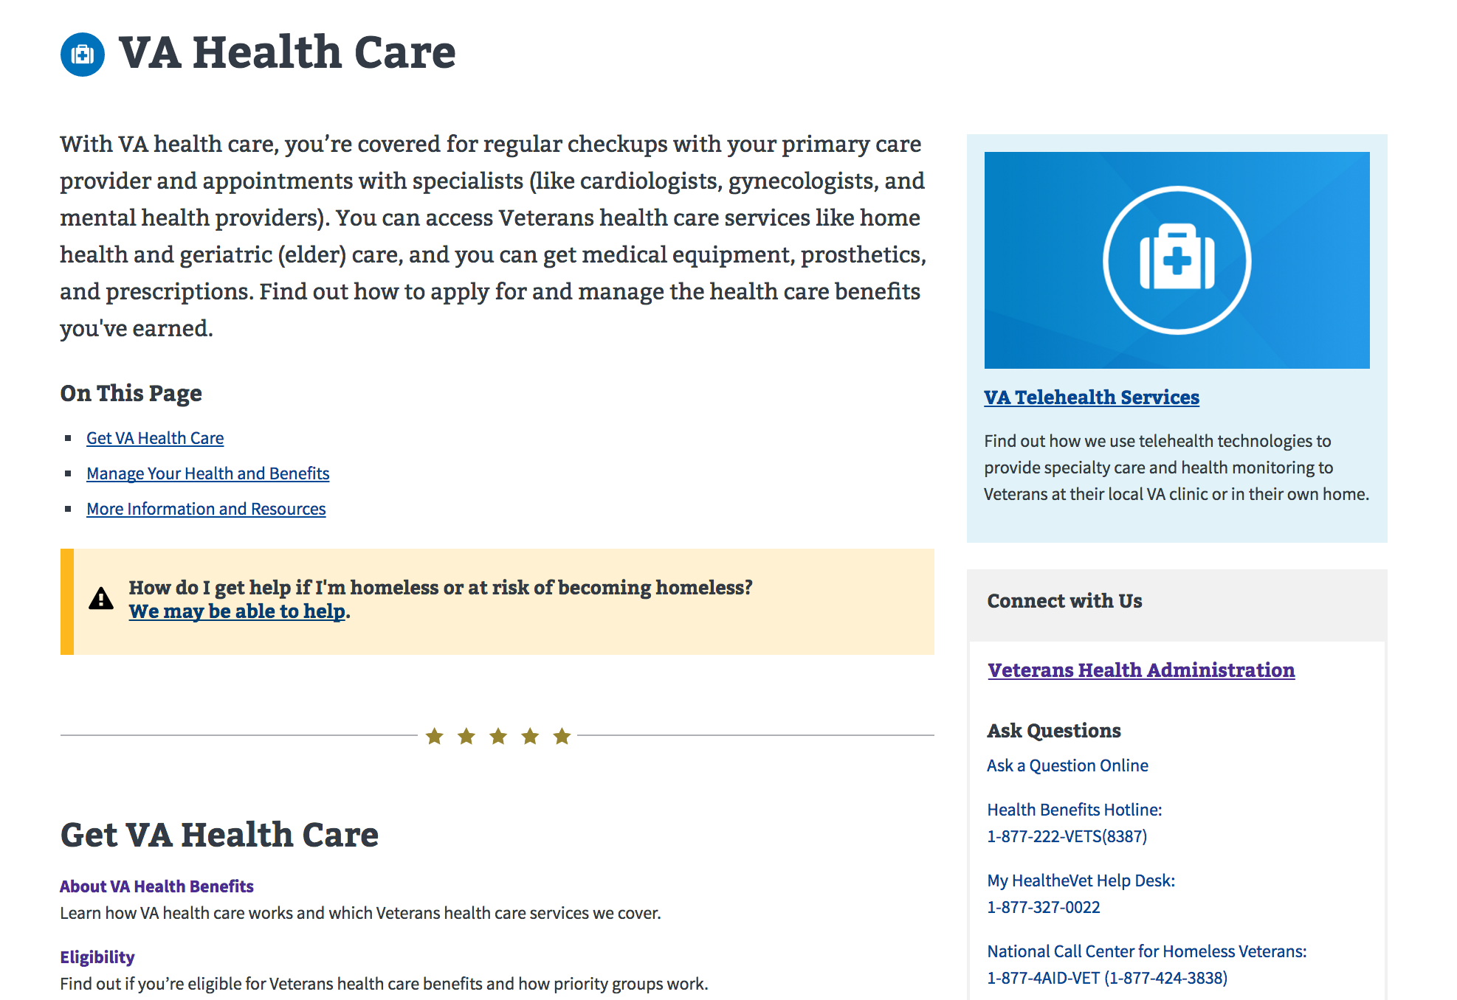
Benefit hubs and tool landing pages
Study 5 – Preview.va.gov Usability Test
Gathered info on the hub design and layout
Focused on the left navigation and call to action buttons on the tool landing pages

Slide 7
What are Veterans saying about preview.va.gov?
Study 5 – Preview.va.gov Usability Test
What are your impressions of this site?
"Nice categories, going to get into the areas that you're in. Looks like you're going to step your way on through” – Mobile P5
If this website went live tomorrow, what would you want other Veterans to know?
“I would encourage them that it’s a little easier to navigate” – Desktop P2
"Not to be afraid of it. It's not intimidating at all. I think without a lot of knowledge about the website you can get to where you need to go.” – Mobile P6

Slide 8
What are Veterans saying about preview.va.gov?
Study 5 – Preview.va.gov Usability Test
How did that compare to your past experiences with VA websites?
“…[old site] lots of clicking, at least 5 minutes to try to hunt down, this is better, a lot more organized, makes it easy to find what you are looking for, it’s right there in front of your face” – Desktop P4
“Everything is on one screen, all 4 areas, its more easier, it would make it more easier for veterans, its more informational, easier to find things.” – Desktop P5

Slide 9
Reception for the preview.va.gov homepage and navigation was extremely positive
Study 5 – Preview.va.gov Usability Test
Veterans liked and understood the benefit categories
The top tasks boxes drew users attention and they commented on the usefulness of the links
Homepage layout exposed Veterans to benefits they may not have considered
Browsing the top navigation worked well in both formats
Users understood the purpose of the “About VA” tab
VCL got good reception and emphasis from Veterans

Slide 10
Veterans called our attention to some improvements
Study 5 – Preview.va.gov Usability Test
The top tasks on the homepage worked well but Veterans overlooked the top navigation generally
The full benefit category list in the middle of the homepage did not catch their attention
Some users commented that the homepage was “flat” or “boring”

Slide 11
The hub and tool landing pages met Veterans needs
Study 5 – Preview.va.gov Usability Test
Users liked the hub page format and were successful browsing the headers, links, and text
Most users understood that many tasks would require sign-in to complete
The sign-in alert on the tool landing pages worked well
We watched across several users as they found multiple routes to key tasks such as Rx Refill

Slide 12
We found potential improvements for the hub and content pages
Study 5 – Preview.va.gov Usability Test
On desktop, the call to action button was outshined by the left navigation, leading users to mistakenly click the highlighted (current page) link
The volume of text on the Hub pages may have been overwhelming to some users
A few users expected to get straight to the sign-in page from the Hubs

Slide 13
What Now?
Study 5 – Preview.va.gov Usability Test
We will continue conducting in-person and remote usability testing on preview.va.gov, specifically drilling into key Veteran tasks to ensure our designs work.

Slide 14
Thank you!
Contact Jeff Barnes with questions:
jeffrey.barnes4@va.gov

